Slide 1
WORLD HAPPINESS REPORT
NEENA MANI

Slide 2
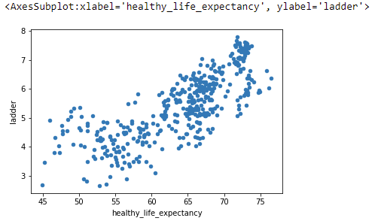
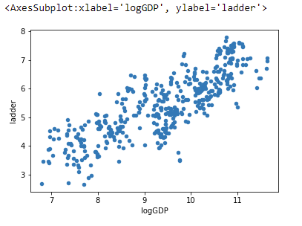
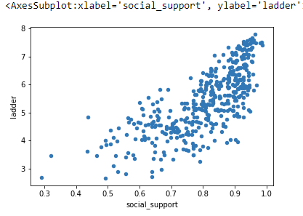
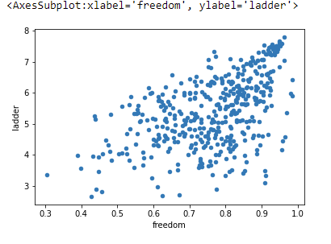
MACHINE LEARNING
To quantitatively define the main factors affecting humans’ subjective sense of happiness and thus develop a method to predict happiness.
Notes:
Read slide.

Slide 3
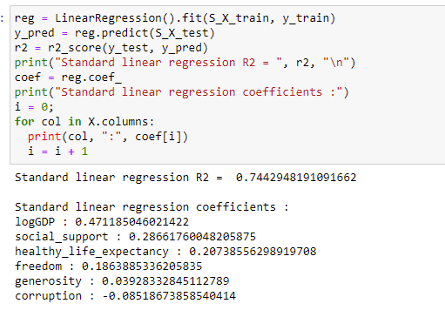
MACHINE LEARNING
Models tried – Standard Linear Regression, Lasso Regression, Ridge Regression
Best performing model is Linear Regression with Standard Scaling of features Used Linear Regression
R2 = 0.74
Highest weights (regression coefficients) for the below features:
GDP, Social Support, Healthy Life Expectancy
Notes:
Read slide.

Slide 4
Thank YOU! Questions?

